Slide 1

ObGyn Watch April 2019
- Narayanan R

Slide 2
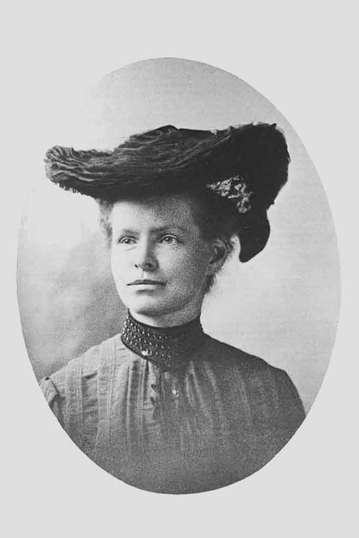
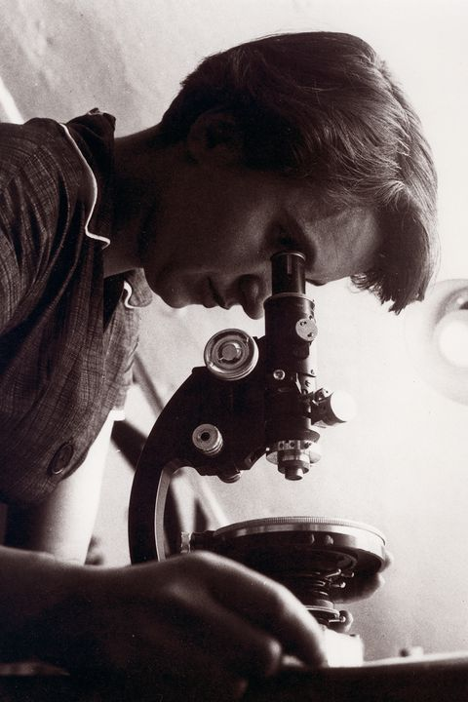
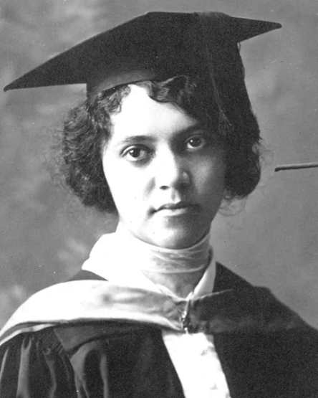
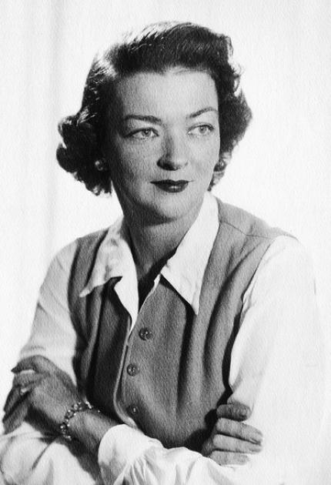
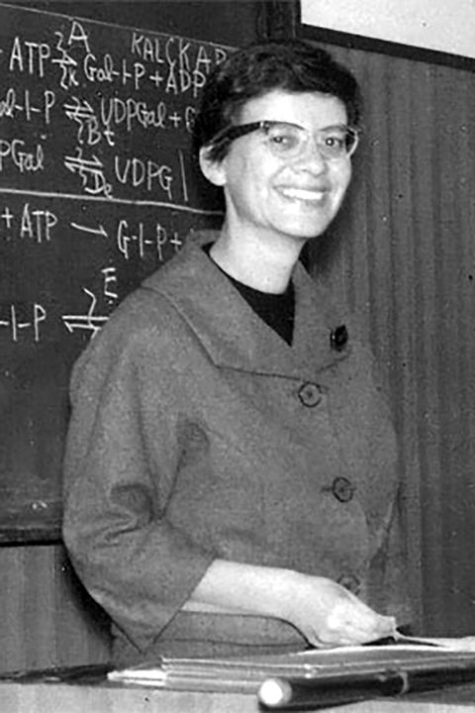
Nettie Stevens
Rosalind Franklin
Sex chrosomes
Sex determination
Structure of DNA
As double helix
Alice Ball
Marion Donovan
Esther Ledenberg
Cure for Leprosy
Disposable diapers for children
Regulation of genes
Process of DNA & RNA
Notes:
March 8, Theme BalanceforBetter - gender balance. Denied merit. Bosses, Research guides & even husbands took the credit.Two were even awarded nobel. Starting with a tribute to women and particularly these women.

Slide 3
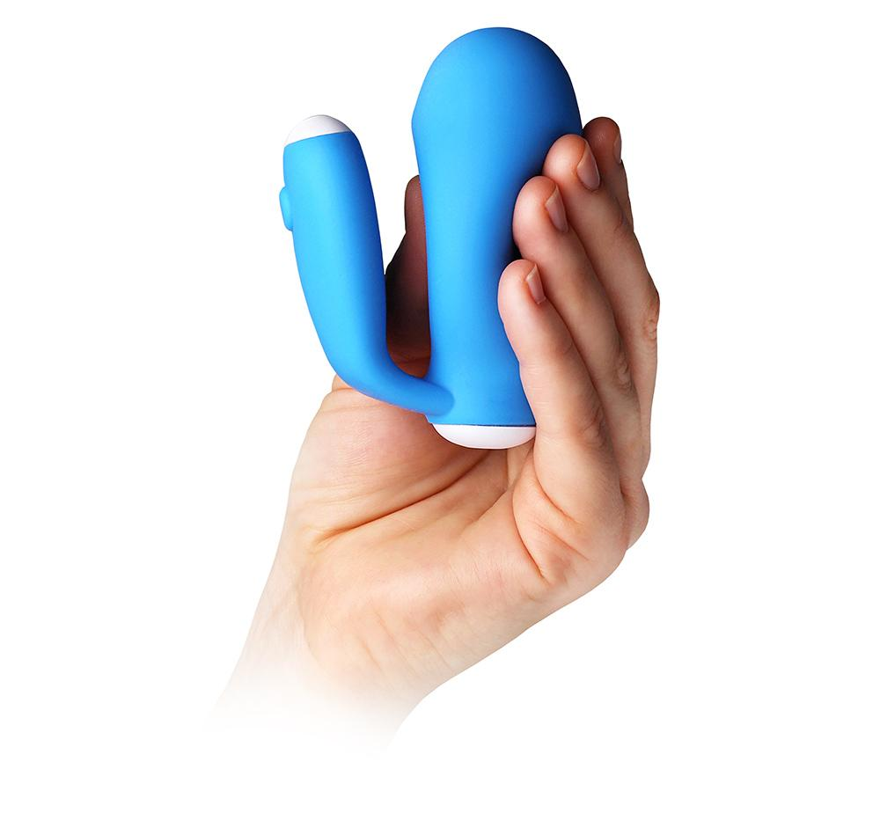
Epi No

Slide 4
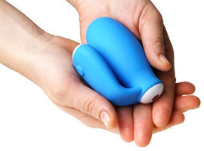
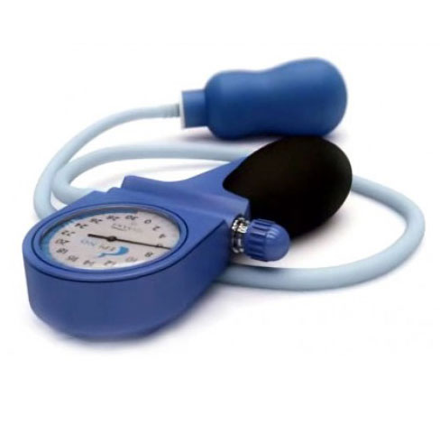
EPI-NO Delphine Plus
A Childbirth and Pelvic Floor Trainer used to prepare the perineum
The bulb is inserted in the vagina & inflated up to almost 10 cm
To reduce the risk of tears and episiotomy during a vaginal birth

Slide 5
Comparison of interventions for
perineal protection to prevent episiotomy
Antenatal perineal massage
Reduces episiotomy rates & post-partum perineal pain
and flatus
Does not prevent post partum anal sphincter or urinary incontinence
Prenatal pelvic floor muscle training exercises
Do not reduce the risk of perineal lacerations
But reduce post-partum urinary incontinence at 3-6 months, but not at 12 months post-partum.
Epi No device
Does not offer perineal protection
-Systematic Review – J Ob Gyn- May 2018

Slide 6

SMARTPHONE CONTRACEPTION
‘Natural Cycles’ approved by FDA
Algorithm digitally analyses BBT record daily to assess fertility
Tested on 22,785 women
Typical use failure: 6.5%
(Center for Disease control & Prevention: 24%)
Ideal use failure: 1.85%
More effective than OCP (9.6%)

Slide 7

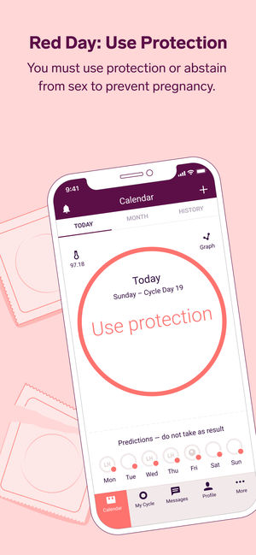


Slide 8
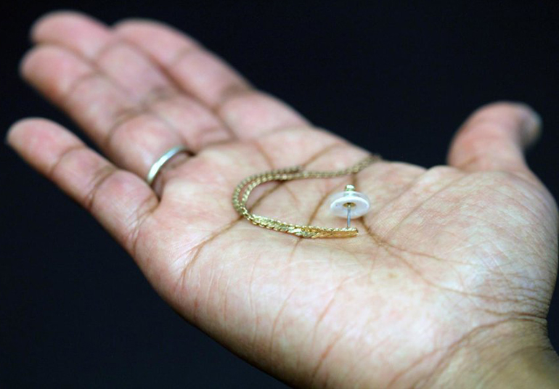

Slide 9
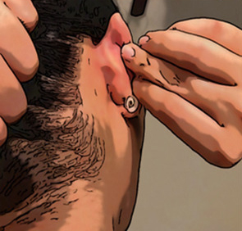
Contraceptive
Jewelry
The jewelry has three layers:
One is used to attach the patch to a piece of jewelry
The middle layer contains a powdered form of LNG
The third layer makes contact with the skin
The drug moves transdermally into the blood stream.
The jewelry releases the hormone at a steady rate (1.7 μg/cm²·h)
LNG level is maintained even if removed before going to bed

Slide 10
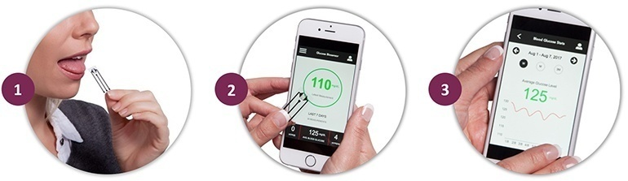
First Noninvasive
Glucose monitoring device
The Biosensor is coated with saliva
Modified organic thin film transistors, in combination with
glucose oxidase, measures Glucose accurately in saliva
3. Cell phone app talks to the biosensor and records value
-Univ of Newcastle Australia

Slide 11
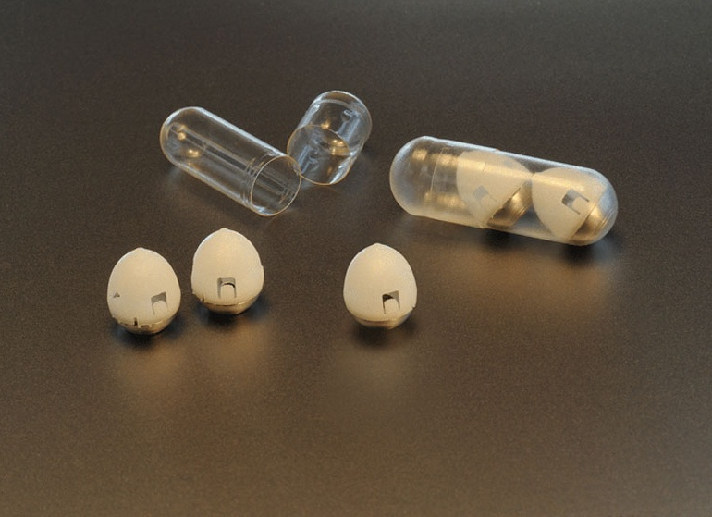
This is no ordinary Pill

Slide 12
Insulin, being a protein, cannot be taken orally in the form of a conventional pill
This pill attaches itself to the walls of the stomach
The injection needle is positioned against the wall of the stomach.
The needle accesses the vasculature within the stomach
Once the insulin is released, the pill detaches from the stomach and leaves the body along with the rest of the excrement
- Journal Science

Slide 13
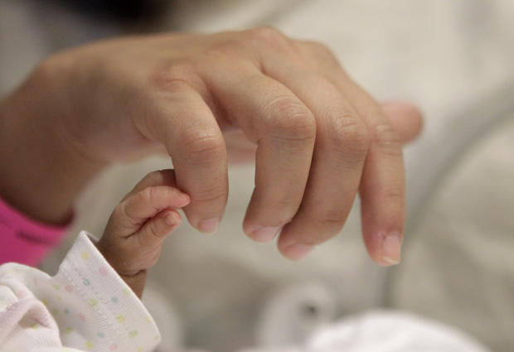
WORLD’S TINIEST

Slide 14

The smallest surviving baby in South East Asia
Gravida 5 Miscarriage 4
Gestational age: 24 weeks
350 Gms
Hyderabad

Slide 15
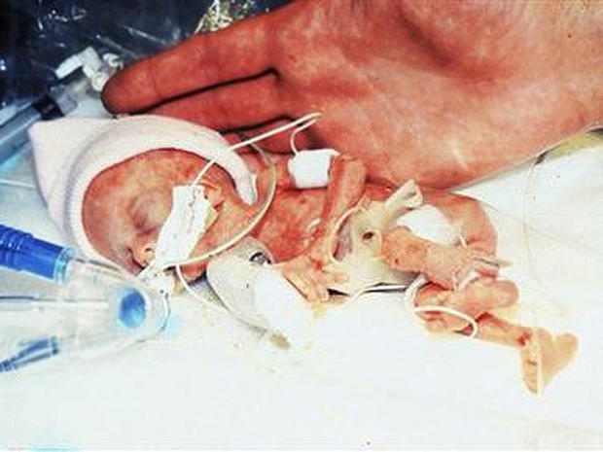

MADELINE MANN 280.5g -1989

Slide 16
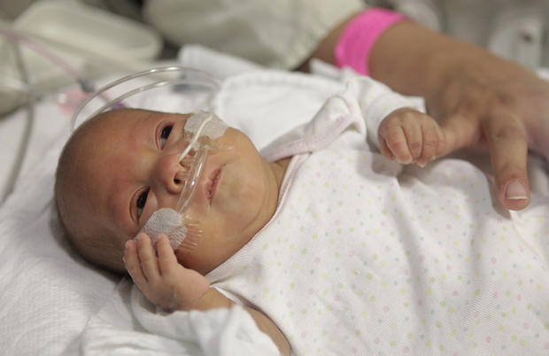
MELINDA STARR GUIDO 270g - 2011

Slide 17
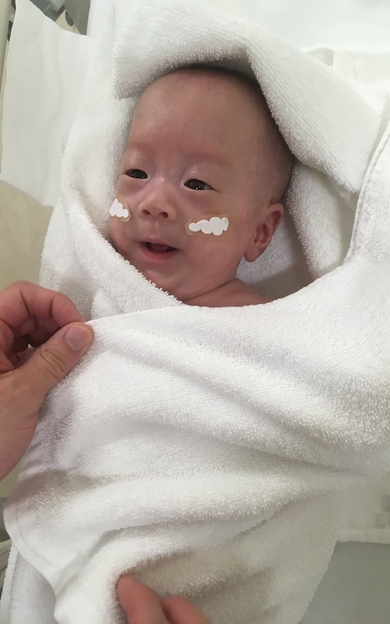
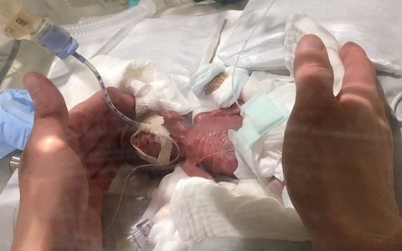
BONSAI BABY 268g

Slide 18
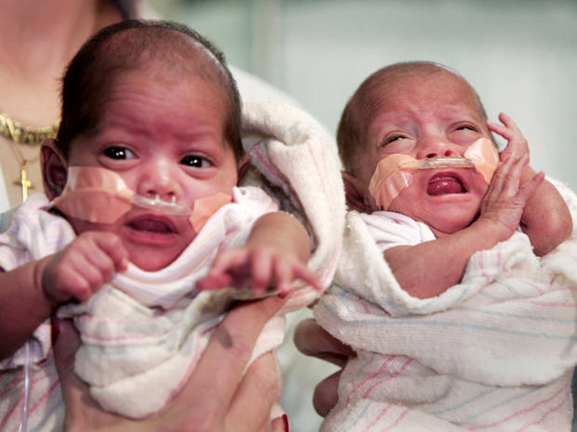
RUMAISA RAHMAN & HIBA 261g/294g -2018

Slide 19
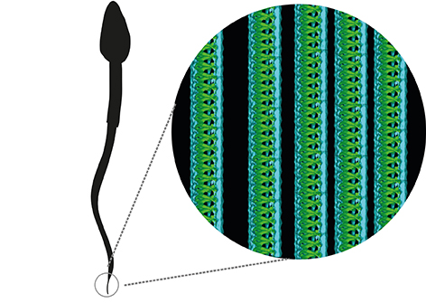
New structure discovered
in human sperm tails
Univ Gothenberg, Feb 2018

Slide 20
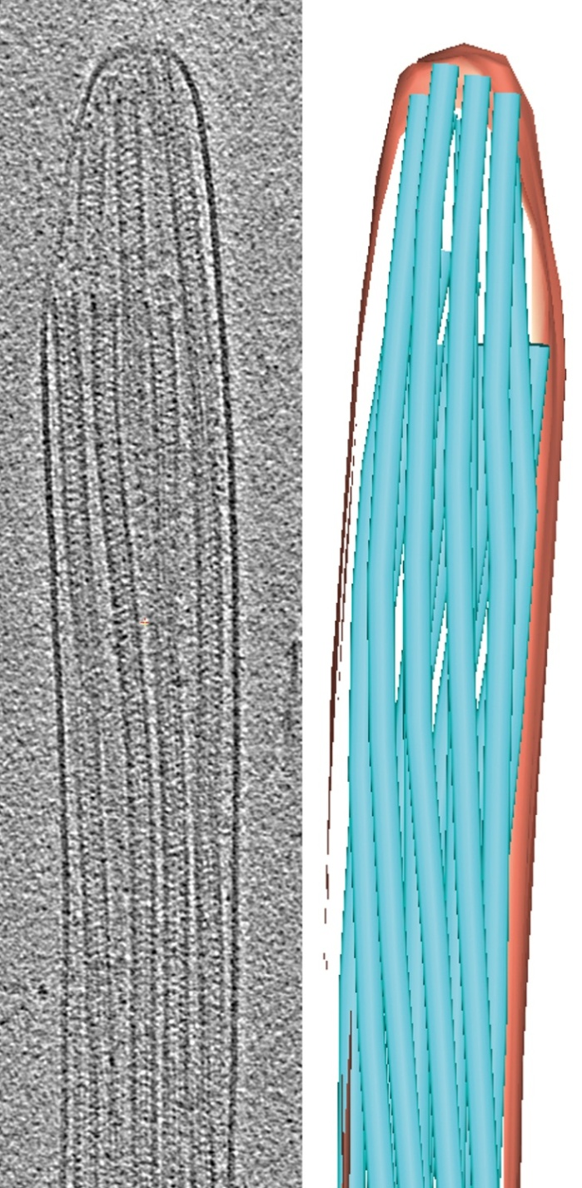
The swimming machine
A highly effective tail is essential for a sperm to be able to swim and to fertilize an egg
The tail consists of thousands of microtubules called Tubulins
These motorproteins which are coordinated in minute detail can move enabling the sperm to swim

Slide 21
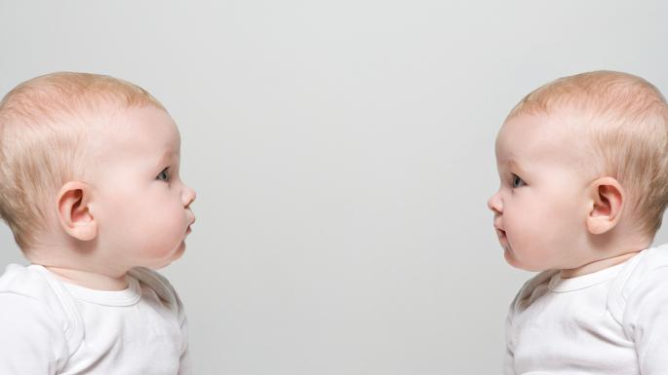
We have heard of monozygotic & Dizygotic Twins. Have you heard of sesquizygotic twins?

Slide 22
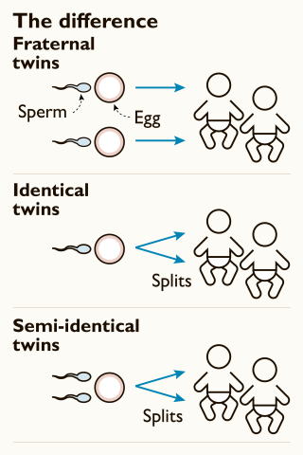
These Australian twins are the second 'semi-identical' pair ever reported
The genetic material split into 3 groups of cells:
One contains chromosomes from both sperm. This embryo can not survive.
One contains chromosomes from the first sperm and the egg
The third contains chromosomes from the second sperm and the egg.
The twins share 100% of maternal genes & 78% of paternal genes
The first set was born in USA in 2007
New England Journal of Medicine

Slide 23

Postpartum depression
Allopregnanolone, a metabolite of progesterone increases in pregnancy and falls sharply after delivery
This leads to Postpartum depression & anxiety
-National Instt of Mental Health, USA

Slide 24
Brexalone
An analog of an endogenous human hormone approved by FDA
60-hour infusion of the drug
Careful monitoring with continuous use of pulse oximetry
Potential side effects: sudden loss of consciousness and excessive sedation
Cost: upwards of $30,000

Slide 25
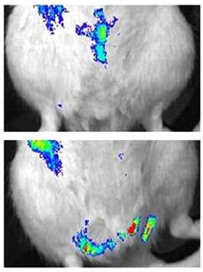
IV Injection of stem cells as a
Cure for Pelvic Floor Disorders
In experiments on rats perineal injury
was simulated by dilation of vagina
IV infused site-specific mesenchymal
stem cells migrated to injury site
within 4 days helping in healing
Healing of pelvic floor injury
due to vaginal delivery may be
facilitated by IV stem cell therapy
-Cruz M et al, Cleveland Clinic

Slide 26
Thank you!

